Slide 1
FCFS Scheduler
CSOPESY – S11
Ralf Wadee L. Hernandez
Marco Luis Gonzales

Slide 2
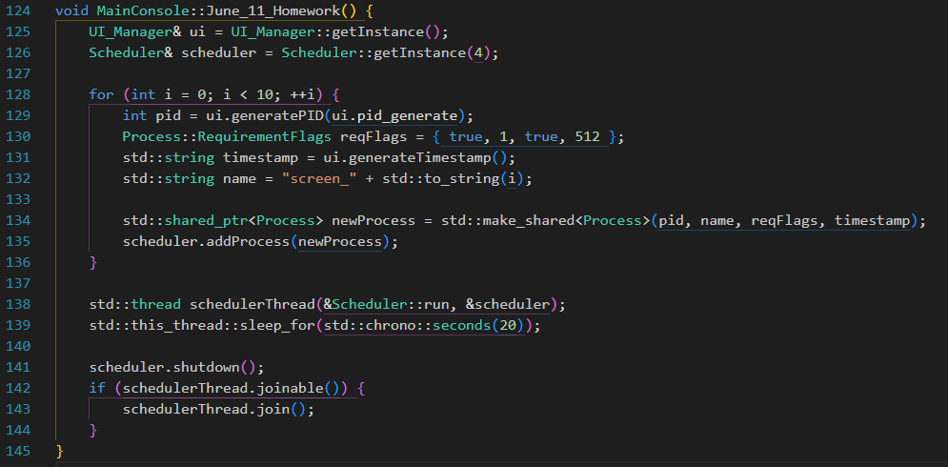
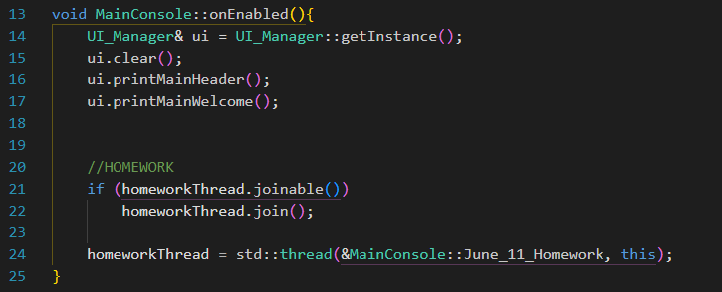
MainConsole Start Thread
Create 10 process and assign to 10 screens; Add processes to screens through scheduler
Start this thread on “onEnabled()”

Slide 3
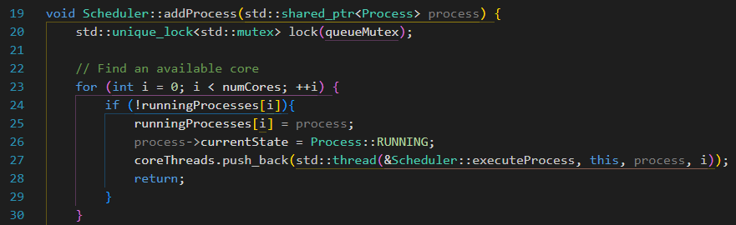
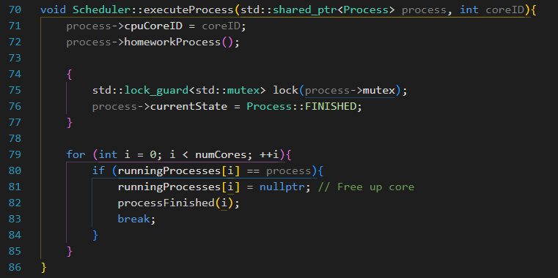
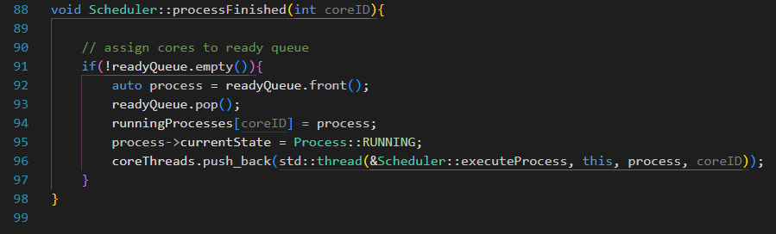
Scheduler
Utilizes mutex to avoid race conditions when executing process and assigning cores (coreID)
Updates the state of the Processes as well.

Slide 4
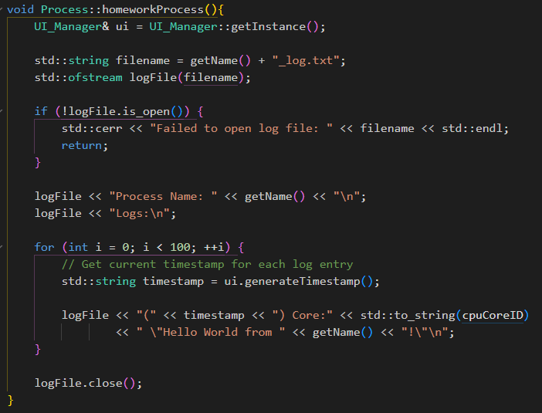
Homework Process
Creates a text file, and prints the desired output 100 times.

Slide 5
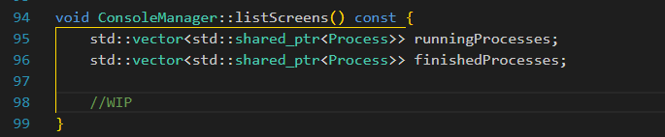
List Screen
Incomplete

Slide 6
Video

Slide 7
End of slides

